Slide 1
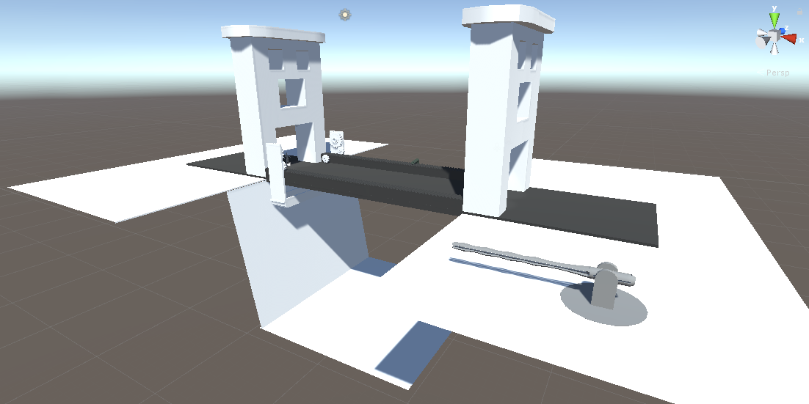
Ship landing
4
5
1
Obstacles
Exit gondola
6
2
Enter gondola
Bridge animation
3
Elevator
8
7
User interaction

Slide 2
Action | Week | Done - improvements
Character movement and camera | 1 | Yes – occlusion of objects
Refinement of week 1 and animation | 2
Particle physics – lightning, jets | 3
Dev diary

